Slide 1


Slide 2
Database Management Systems
Week 1, Day 5
MySQL—A RDBMS
Atta Muhammad
+92-333-1971110
attapanhyar@quest.edu.pk

Slide 3

RECAP
Order by
Insert into
Update …set
Delete

Slide 4
LIKE Operator
The LIKE operator is used in a WHERE clause to search for a specified pattern in a column.
The percent sign (%) represents zero, one, or multiple characters
The underscore sign (_) represents one, single character

Slide 5
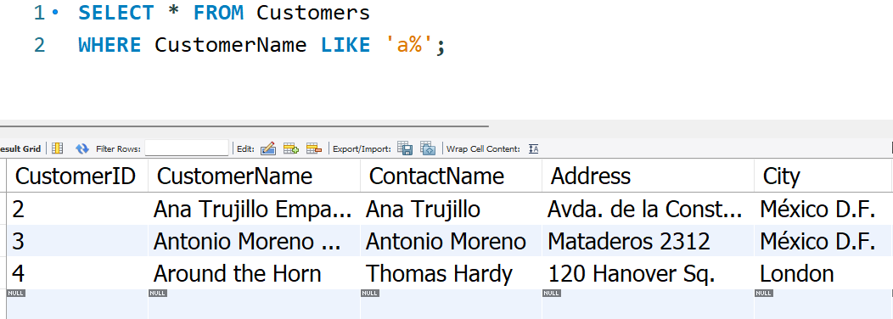
Like operator
Example:

Slide 6
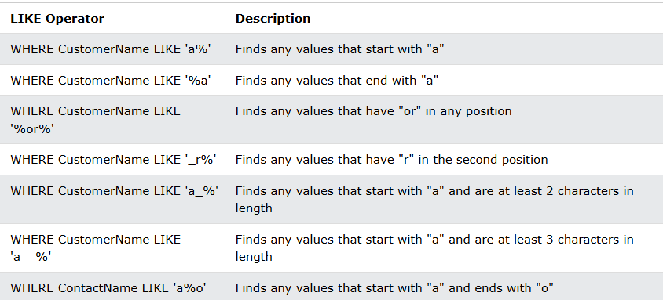
Like operator …

Slide 7
IN Operator
The IN operator allows you to specify multiple values in a WHERE clause.
The IN operator is a shorthand for multiple OR conditions.

Slide 8
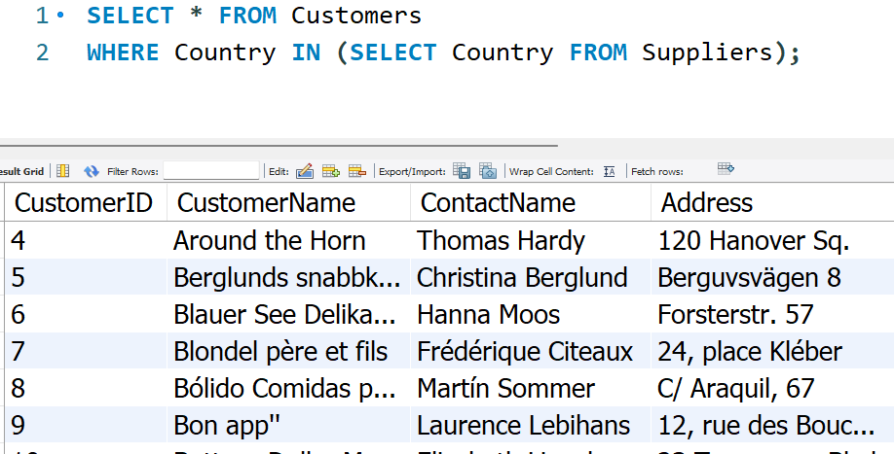
IN Operator

Slide 9

Aliases
Aliases are used to give a table, or a column in a table, a temporary name.
Aliases are often used to make column names more readable.
An alias only exists for the duration of that query.
An alias is created with the AS keyword.

Slide 10
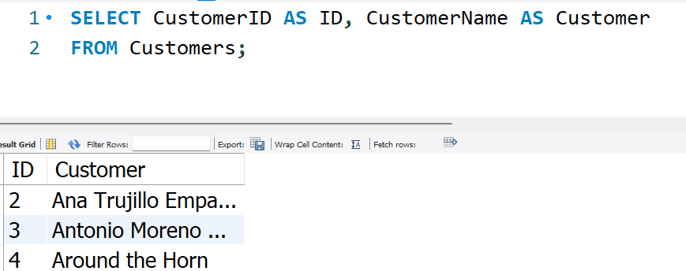
Example 1

Slide 11
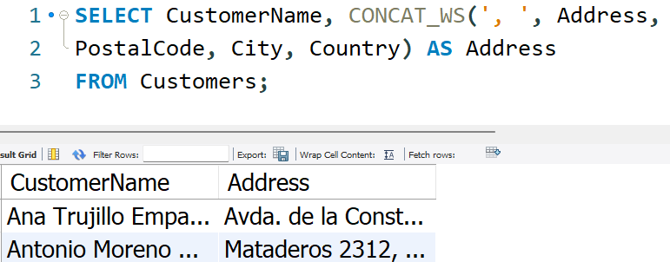
Example 2

Slide 12
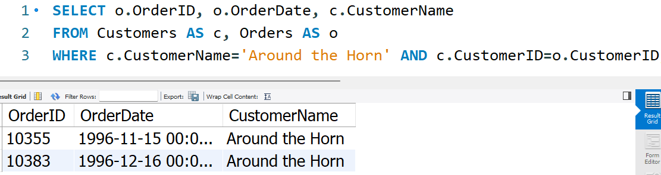
Example 3

Slide 13
JOINS

Slide 14
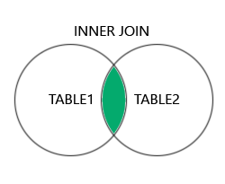
INNER JOIN
The INNER JOIN keyword selects records that have matching values in both tables.

Slide 15

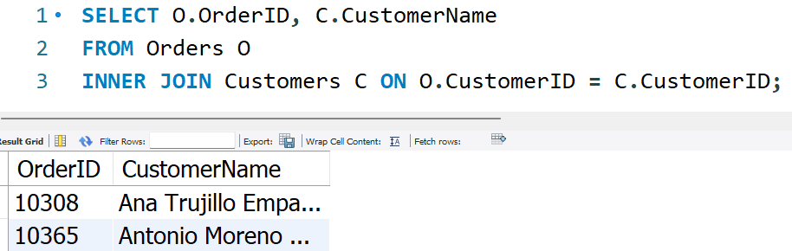
INNER JOIN –Example

Slide 16
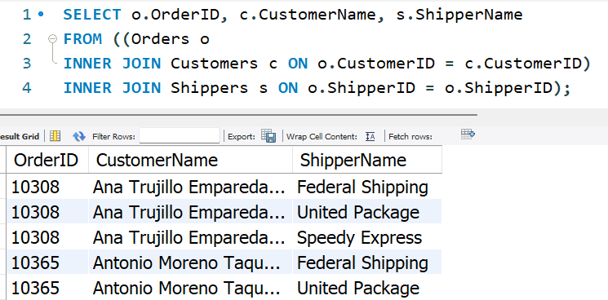
Example 2

Slide 17
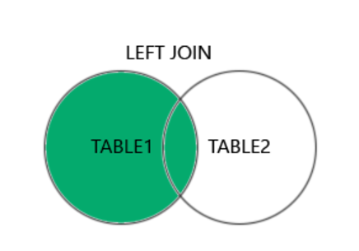
LEFT JOIN
The LEFT JOIN keyword returns all records from the left table (table1), and the matching records (if any) from the right table (table2)

Slide 18
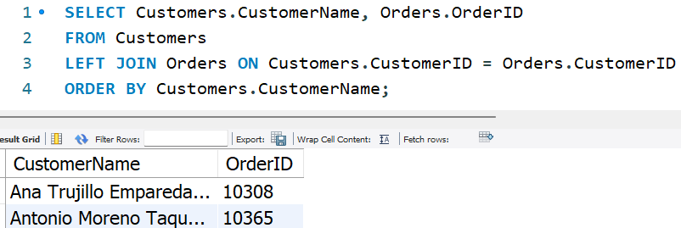
LEFT JOIN –Example

Slide 19
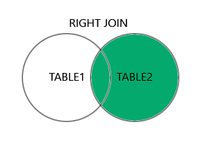
RIGHT JOIN
The RIGHT JOIN keyword returns all records from the right table (table2), and the matching records (if any) from the left table (table1).

Slide 20
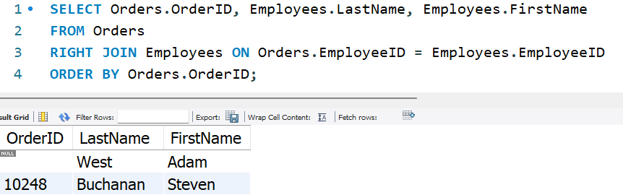
RIGHT JOIN –Example

Slide 21
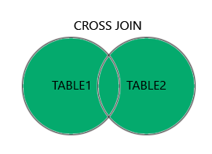
CROSS JOIN
The CROSS JOIN keyword returns all records from both tables (table1 and table2).

Slide 22
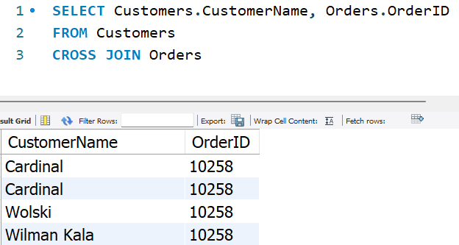
CROSS JOIN –Example

Slide 23
UNION
The UNION operator is used to combine the result-set of two or more SELECT statements.
Every SELECT statement within UNION must have the same number of columns
The columns must also have similar data types
The columns in every SELECT statement must also be in the same order.

Slide 24
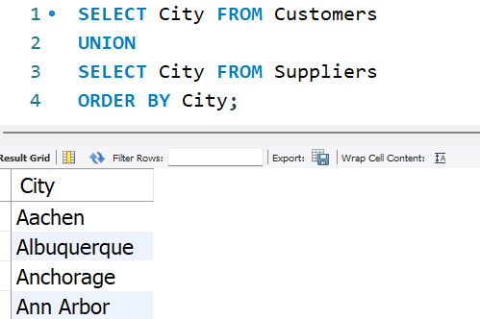
UNION

Slide 25
GROUP BY
The GROUP BY statement groups rows that have the same values into summary rows, like "find the number of customers in each country".
The GROUP BY statement is often used with aggregate functions (COUNT(), MAX(), MIN(), SUM(), AVG()) to group the result-set by one or more columns.

Slide 26
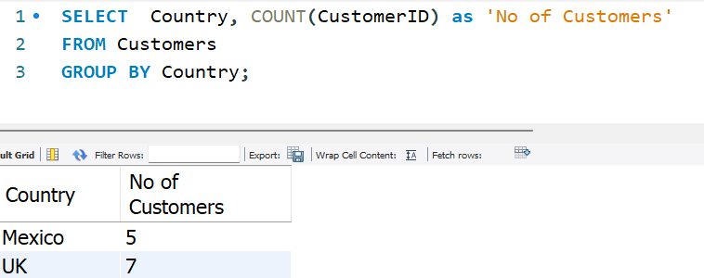
GROUP BY

Slide 27
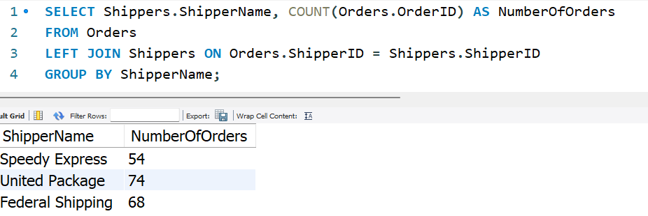
COMPLEX QUERY

Slide 28
HAVING Clause
The HAVING clause was added to SQL because the WHERE keyword cannot be used with aggregate functions.

Slide 29
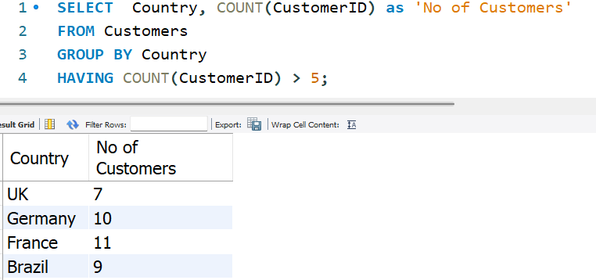
HAVING Clause

Slide 30
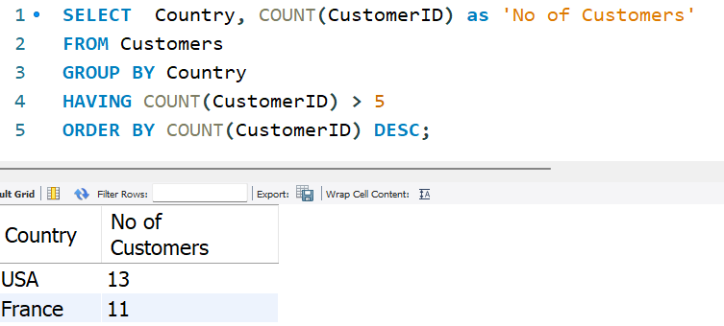
HAVING Clause

Slide 31
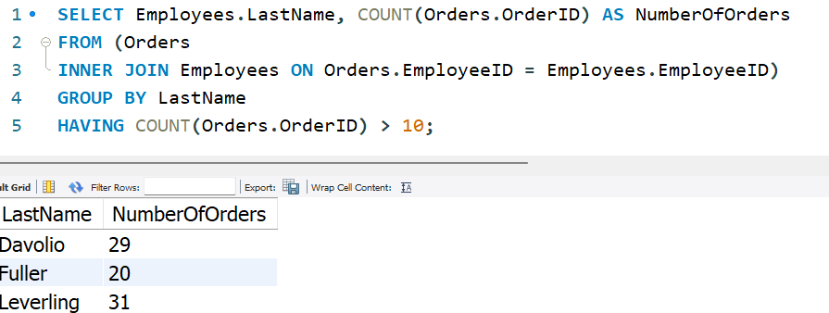
HAVING CLAUSE

Slide 32
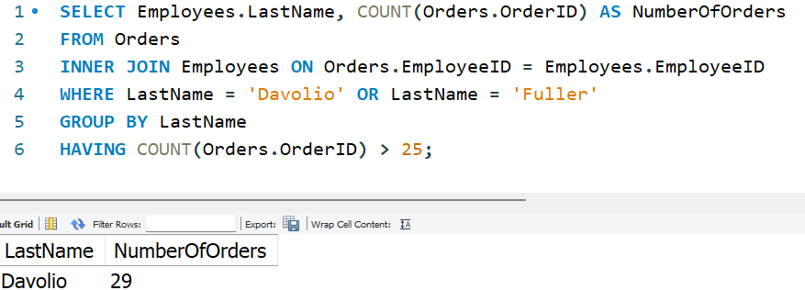
HAVING –One more 💎

Slide 33
Question(s)

